Slide 1
TITLE OF PROJECT
BIOMETRIC VEHICLE STARTING SYSTEM USING ARUDINO

Slide 2
Content
INTRODUCTION
WHY BIOMETRIC
HOW IT IS WORK
HARDWARE REQUIREMENT
BLOCK DIAGRAM
CIRCUIT DIAGRAM
FLOWCHART
ADVANTAGES
APPLICATIONS
CONCLUSION

Slide 3
INTRODUCTION :
Innovating vehicle security with biometric fingerprint starting system using Arduino. Enhancing security and convenience for vehicle owners. Revolutionizing the way vehicles are accessed and started. Biometric authentication provides a high level of security and eliminates the need for traditional keys or fobs.
The increasing number of vehicle thefts necessitates more secure and personalized solutions for vehicle immobilization and access. Replacing traditional key-based ignition systems, this project proposes a biometric vehicle starting system using Arduino, enhancing security and user convenience.

Slide 4
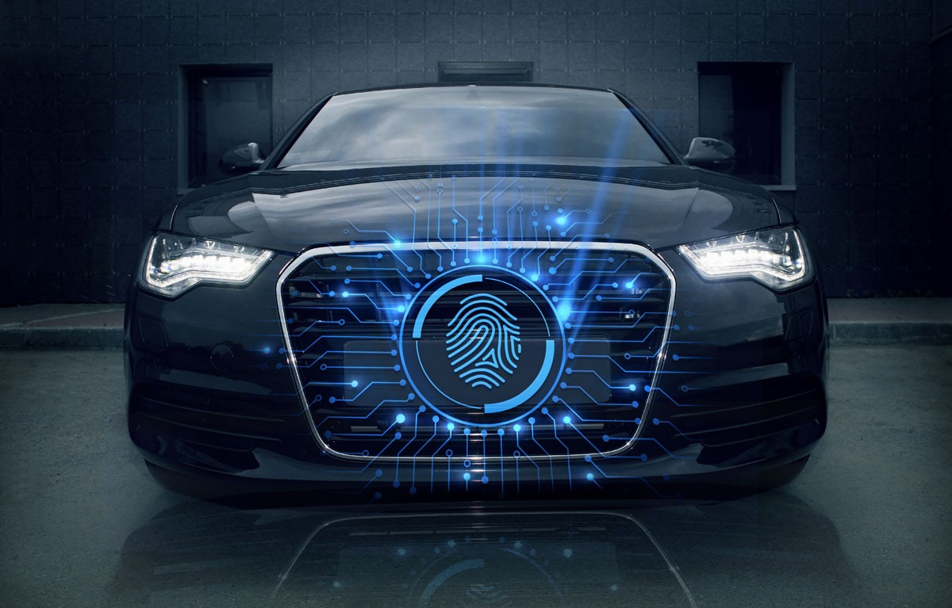
why biometric :
The fingerprint biometric security system is widely used. Because each person's finger is unique this method is more secure.
Unlike passwords, biometrics eliminates the need to remember anything. Biometric authentication leverages unique physical or behavioral traits to identify, verify, or authenticate our identity.

Slide 5
How it is work:
When input is given to the fingerprint sensor, it scans the finger.
Matching fingerprints will activate the relay that controls the starter relay.
This will start the engine.
The fingerprint sensor will then turn off.
If no finger was scanned it will display finger not found. Please try again. The fingerprint sensor will not start the vehicle engine.

Slide 6
HARDWARE REQUIREMENT :
ARUDINO UNO
Features Of Arduino Uno:
The ATmega328p is a Microcontroller.
The operating voltage of this microcontroller is 5 volts.
Flash memory of 32kb.
SRAM of 2kb.
EEPROM of 1kb.

Slide 7
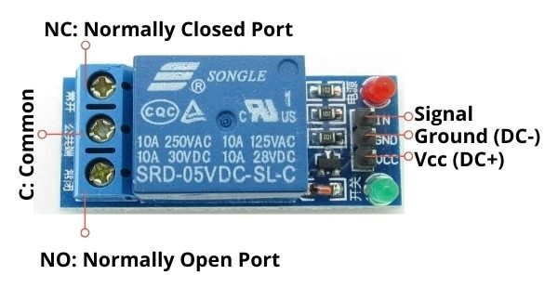
HARDWARE REQUIREMENT :
2) RELAY
A relay is an electrically operated switch. It consists of a set of input terminals for a single or multiple control signals, and a set of operating contact terminals.
Normal voltage 5 v.

Slide 8
HARDWARE REQUIREMENT :
3) LCD DISPLAY:
Operating voltage is 4.7v to 5.3v
It includes two rows where each row can produce 16 characters.

Slide 9
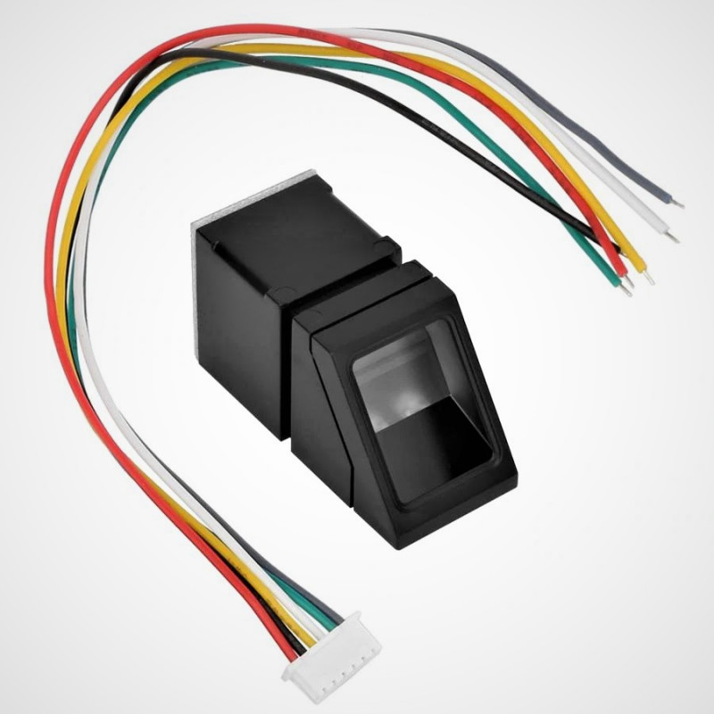
HARDWARE REQUIREMENT :
4) BIOMETRIC SENSOR:
The definition of a biometric sensor is an identification & authentication device that uses automated methods of recognizing or verifying the characteristics, of a living person depending upon physical attribute like fingerprints
Operating voltage 3.3 to 7.5v
It supports any microcontroller with UART.

Slide 10
HARDWARE REQUIREMENT :
5) JUMPER WIRES:
A jumper wire is an electric wire that connects remote and short-cut (jump) to the electric circuit. electric circuits used for printed circuit boards. By attaching a jumper wire on the circuit, it can be short circuited

Slide 11
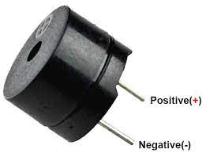
HARDWARE REQUIREMENT :
5) BUZZER:
Operating voltage ranges from 3v to 24v.
The sound pressure level is 85dbA.
Operating temperature ranges from – 20° C to +60°C.
The frequency range is 3,300Hz.

Slide 12
BLOCK DIAGRAM :
ARUDINO UNO
LCD
FINGERPRINT SENSOR
RELAY
ON / OFF IGNITION SYSTEM
POWER SUPPLY
BUZZER

Slide 13
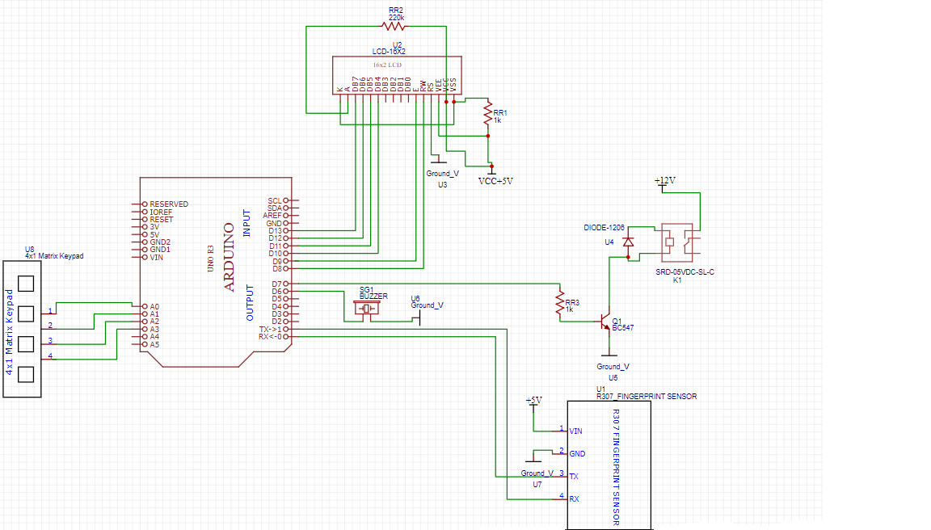
CIRCUIT DIAGRAM :

Slide 14
Start
FLOWCHART:
Read Signal From Fingerprint Sensor
Scanning and Matching Fingerprint
Fingerprint Matched
ID Not Matched
No
Yes
Display User Identity
Engine Ignition Started
Stop

Slide 15
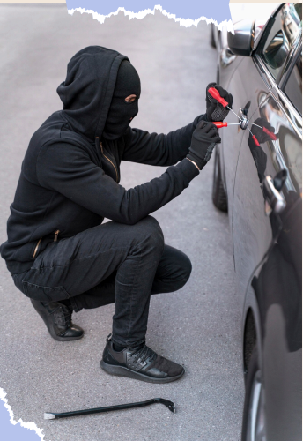

Advantages:
Enhanced security through unique biometric identification.
Ease to use and user friendly.
Processing speed is fast.
Reduced risk of vehicle theft and unauthorized access.

Slide 16
APPLICATION:
Cars
Motor cycle
Transport vehicle
Home security system
Lockers

Slide 17
Conclusion:
This work is a well operating prototype of a fingerprint based car starting system. Hence, fingerprint technology improves the security of an automobile making it possible for the car to be used by only authorized users.

Slide 18
THANK YOU

